Slide 1
Bias and Fairness in AI

Slide 2
Member Contributions
Chen Yu Hang 1211107973: Abstract, Introduction, Literature Review, Conclusion, Discussion
Vishnunanda Surain 241UC241C3: Literature Review, Critical Analysis, Discussion
Vinnosh Rau A/L Samudram 1211108264: Crtitical Analysis, Discussion
Thong Yun Peng 1211107295: Comparative Analysis and Synthesis, Discussion

Slide 3
Introduction
- Bias & Fairness in AI: Critical for ethical technology use.
- impact of Data Bias: Can lead to skewed outcomes in areas like hiring, healthcare, and law enforcement.
- Potential Harm: May reinforce societal inequalities.
- Fairness Goal: Ensures equitable treatment and decision-making across all demographics.
- Importance: Addressing bias is essential for responsible, inclusive AI that curbs discrimination and promotes societal benefits.

Slide 4
Problem Statement
How does AI algorithm compile data before making an unbiased and fair decision and how to enhance them?

Slide 5
Justification/Motivation
- Paramount Importance: AI influences critical decisions in key areas.
- Prevents Discrimination: Ensures fair, unbiased systems.
- Promotes Ethical Use: Maintains moral standards in AI.
- Fosters Public Trust: Builds confidence in AI for all communities.

Slide 6
Research questions
In what ways do biases in data, algorithms, and human judgment lead to unfair results in AI systems?
How do biases in generative AI shape societal perceptions, and what factors contribute to this issue?
Are the current methods for reducing bias in AI effective at addressing inequalities?
Can tools like AIF360 help promote fairness in AI systems, especially in critical fields like healthcare?

Slide 7
Hypothesis
AI models trained on biased data are more likely to perpetuate societal inequalities.
Techniques like data preprocessing and post-processing can meaningfully reduce bias in AI.
Generative AI is more prone to reinforcing stereotypes because of the biases in its input data.
Using fairness-focused tools like AIF360 will lead to more equitable decisions in AI systems.

Slide 8
Research Objectives
To uncover the sources of bias in AI systems and understand their effects on decisions.
To analyze how well different strategies for reducing bias work in creating fairer outcomes.
To examine how biased AI affects society, particularly in areas like healthcare and law enforcement.
To explore how tools like AIF360 can be applied to reduce bias in AI systems used in real-world scenarios.

Slide 9
Literature review Summary
- AI Bias and Fairness: Key concern in AI integration; biased data can lead to discrimination against marginalized groups.
- Machine Learning Fairness: Focus on removing bias related to attributes like race, gender, and socioeconomic status.
- Mitigation Tools: IBM AI Fairness 360, Google What-If Tool, and Microsoft Fairlearn are used to detect and reduce biases.
- Bias Types: Highlights historical and aggregation bias, affecting AI decision-making processes.
- Critique: Papers propose bias mitigation methods but lack real-world evidence and detailed analysis of fairness constraints.
- Call for Further Research: More data and validation needed to assess bias mitigation techniques effectively.

Slide 10
Research Methodology
- Objective: Address biases in AI systems using technical and ethical perspectives.
- Steps Involved:
1. Data Collection: Gather datasets (UCI, Kaggle) and preprocess for quality.
2. Bias Identification: Use IBM AI Fairness 360, Google What-If Tool, and Microsoft Fairlearn to detect biases.
3. Bias Mitigation:
- Pre-processing: Modify data (e.g., reweighting).
- In-processing: Adjust algorithms during training (e.g., adversarial debiasing).
- Post-processing: Recalibrate model outputs.
4. Model Training and Evaluation: Train models (Logistic Regression, Random Forest, Neural Networks) and evaluate using fairness and accuracy metrics.

Slide 11
Research Methodology
5. Comparative Analysis: Use statistical methods (t-tests, ANOVA) to compare models.
6. Ethical Evaluation: Gather feedback from stakeholders on ethical implications.
- Evaluation Metrics:
- Statistical Parity Difference: Compare positive outcome rates across groups.
- Equalized Odds: Assess false positive/negative rate equality.
- Accuracy: Overall model performance.
- False Positive Rate Disparity: Check differences in false positives across demographics.
- Equal Opportunity Difference: Evaluate equality of true positive rates.

Slide 12
Research Methodology
- Challenges:
- Computational Costs: Some techniques (e.g., adversarial debiasing) are resource-intensive.
- Data Distortion: Pre-processing may distort original datasets.

Slide 13
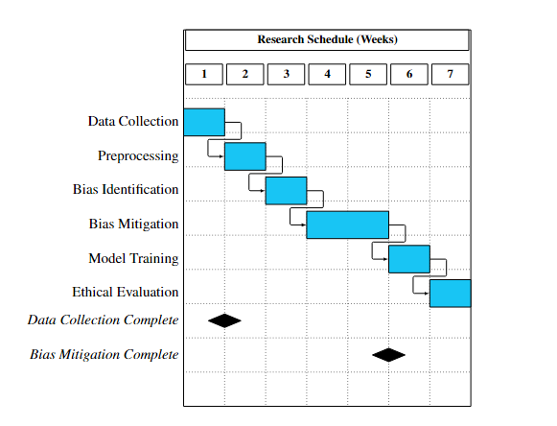
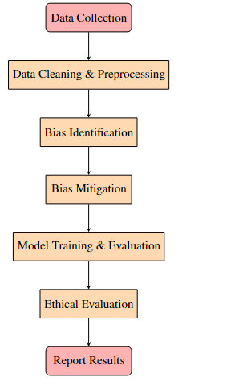
Research Activities and milestones
Flowchart Of Research Activities
Gantt Chart for Research Timeline

Slide 14
Expected results and impact
- Understanding Bias Origins: Identify sources of bias in AI, including data, algorithms, and human decisions.
- Effectiveness of Mitigation Strategies: Compare bias mitigation techniques and assess their impact on fairness in healthcare and criminal justice.
- Role of Fairness Tools: Demonstrate the practicality and limitations of tools like IBM AI Fairness 360 and Microsoft Fairlearn for addressing bias in real-world applications.

